Slide 1
CS 4530 & CS 5500
Software Engineering
Lecture 11.2: Ethics in Software Engineering
Jonathan Bell, John Boyland, Mitch Wand
Khoury College of Computer Sciences © 2021, released under CC BY-SA

Slide 2
Learning Objectives for this Lesson
By the end of this lesson, you should be able to…
Articulate the ethical responsibilities of professional software engineers
List a set of questions that you can ask to evaluate the public impact of software

Slide 3
Professional Ethics
Professional standards
By 1675, standards established for: divinity, law, medicine
Professionals exercise specialist knowledge or skill - professional ethics governs how this knowledge should be governed
12th-century Byzantine manuscript of the Hippocratic Oath
Notes:
Before getting into ethics for software engineering, it’s useful to think about the origins of professional ethics. “Professionals” in this context generally refers to individuals who exercise some special knowledge that the public-at-large does not hold. When a professional provides services to a layperson, it is important for that layperson to be able to trust that they are not being taken advantage of. For example, the earliest instance of professional ethics is likely the hippocratic oath, which is rooted in doing no harm. Professional ethics standards exist for many different professions.

Slide 4
Code of Ethics
Professional Engineers
Engineers, in the fulfillment of their professional duties, shall:
Hold paramount the safety, health, and welfare of the public.
Perform services only in areas of their competence.
Issue public statements only in an objective and truthful manner.
Act for each employer or client as faithful agents or trustees.
Avoid deceptive acts.
Conduct themselves honorably, responsibly, ethically, and lawfully so as to enhance the honor, reputation, and usefulness of the profession.
National Society of Professional Engineers - Code of Ethics for Engineers
Notes:
Given that we’re talking about SOFTWARE engineering, it’s particularly useful to consider the closely related ethical problems that arise in civil engineering. Whereas it might be difficult to identify an immediate risk to life from a failure of most software, it is much easier to see how a miscalculation in the design of a building could result in the building to collapse, which would be catastrophic. Professional engineers are required to receive significant training in ethics to ensure that they understand the importance of, above all, ensuring the safety, health and welfare of the public. The building shown on this slide, the Citigroup tower in new york city, provides a particularly interesting case study of ethics in engineering.

Slide 5
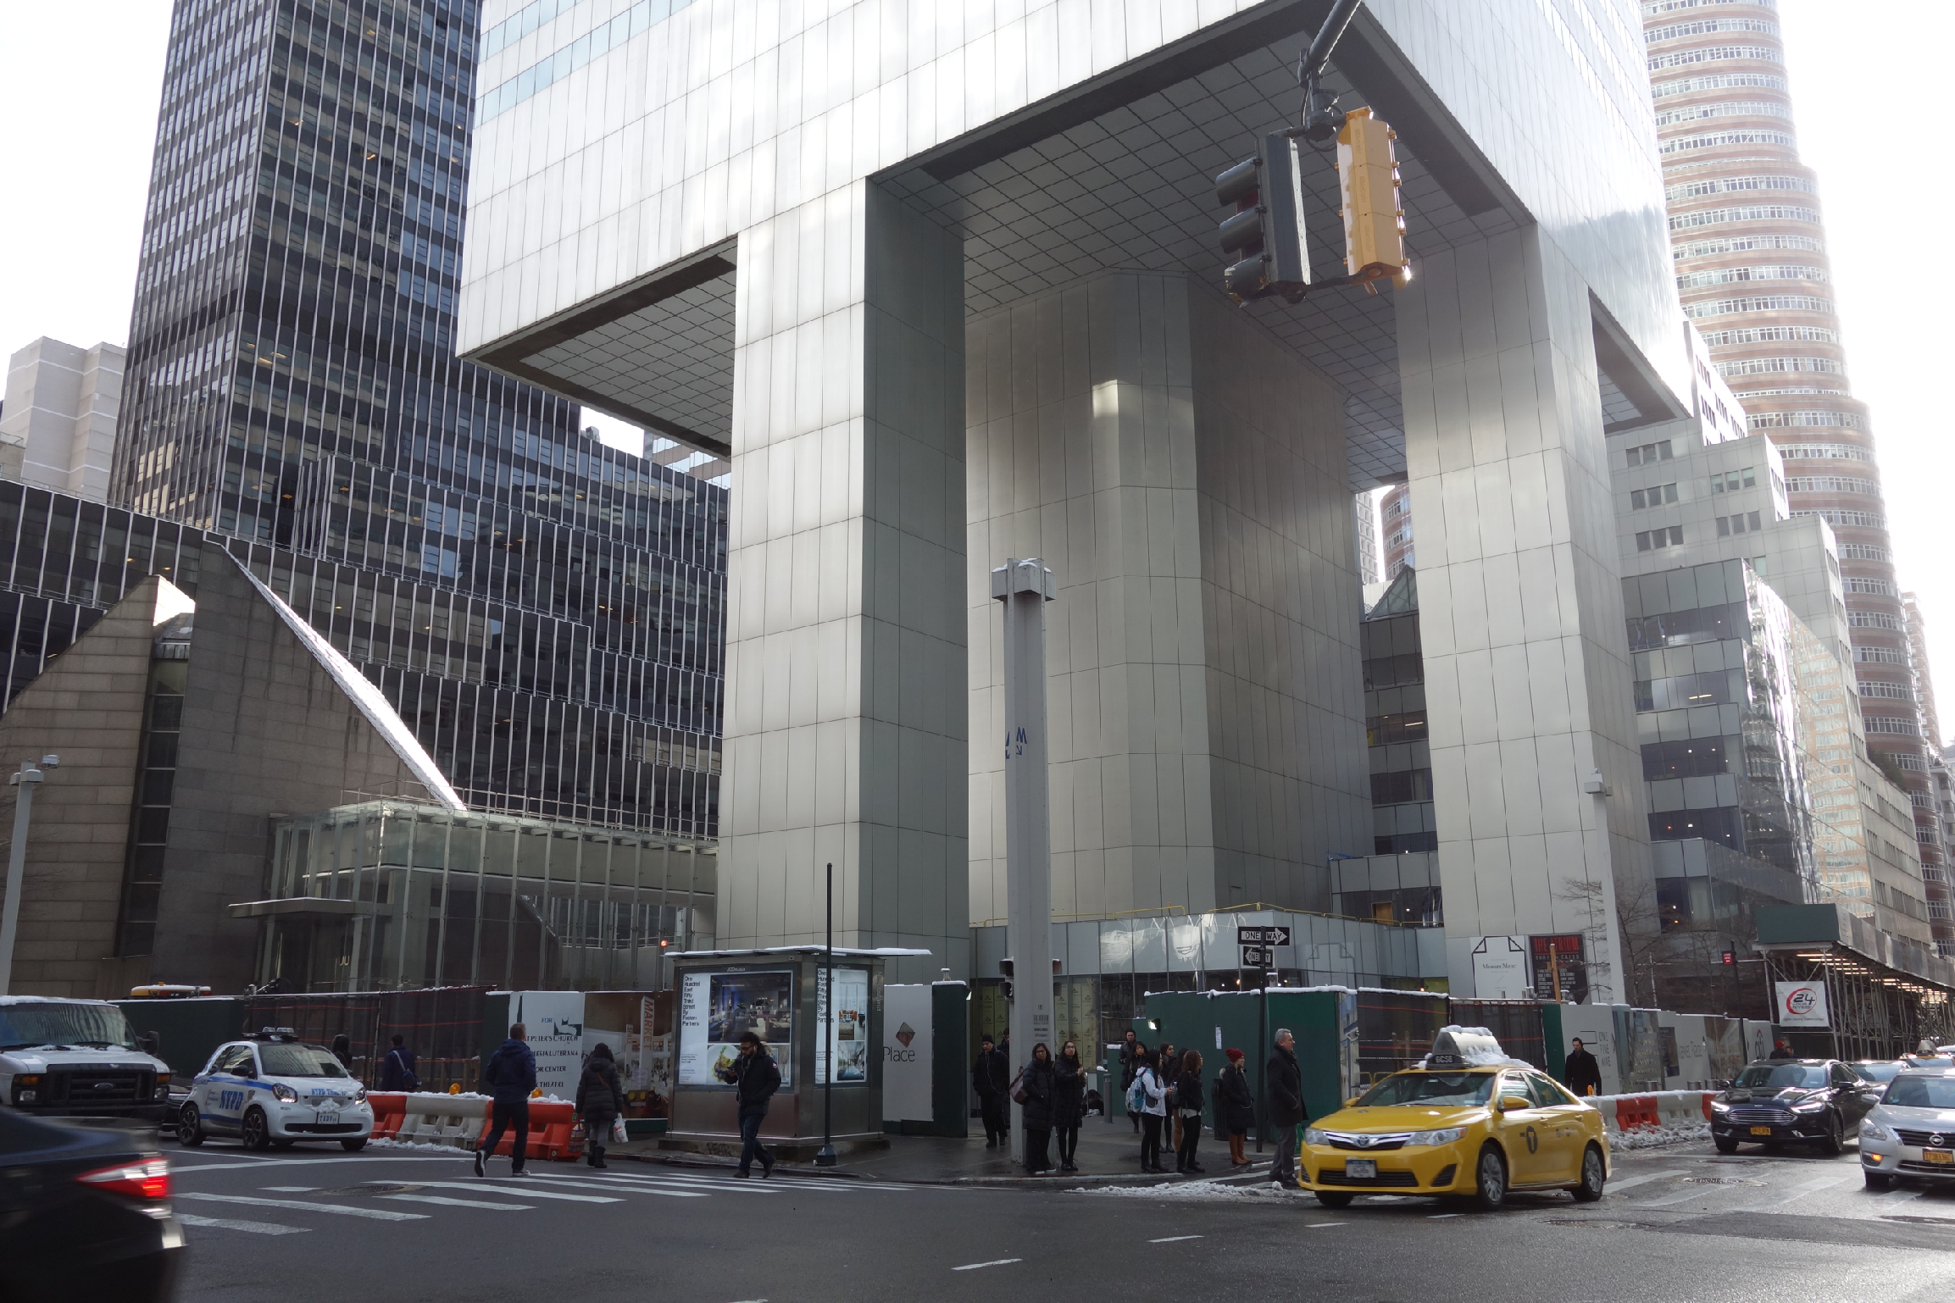
Code of Ethics
Professional Engineers: Citigroup Center
Design met building code, but did not account for all failure modes
Last-minute changes to construction increased odds of failure
Fixed before disaster could strike, but kept a secret for 20 years
https://www.theaiatrust.com/whitepapers/ethics/study.php
“Citigroup Center” by Tdorante10, Wikimedia commons, CC BY-SA 4.0
Notes:
Here’s a photo of the bottom of Citigroup Center, which was built 1974. It’s a very interesting building design: a 59 story tower cantilevered over a church - note this unique column architecture supporting the building. The engineer, LeMessurier, created a design that met building code (which in particular, required the design to be resilient to winds from N/S/E/W), but an analysis by an undergrad’s senior thesis found a diagonal hurricane-force wind would quite likely blow over the building. Usually face-on winds are the worst (for a building with columns on corners), but this building had columns in middle! Would have been OK if bottom joints were welded, but steel contractor wanted to bolt them to save millions of dollars, and was OKed. Fixed by the engineering firm, quite quickly, but also quietly. While being fixed added extra precautions to ensure safety and monitor weather, with evacuation plans. Kept secret for 20 years! This is a very interesting case study: note that the engineer did follow regulations, but still did not ensure safety in their design. Thankfully, the flaw was found by the student, and the engineering firm quickly took action to repair it, taking responsibility for the problem. One interesting discussion point here, however, is regarding how it was repaired - in secret! Do you think that this design flaw should have been made immediately public?

Slide 6
Code of Ethics
Software Engineers: Therac-25 (1985-1987)
Bug in software caused 100x greater exposure to radiation than intended
At least 6 died
Likely far more suffered: deaths occurred over a period of 2 years!
Weak accountability in manufacturer’s organization
“Therac-25” by Catalina Márquez, Wikimedia commons, CC BY-SA 4.0
https://ethicsunwrapped.utexas.edu/case-study/therac-25
Notes:
In contrast to the Citigroup tower case, where the engineering firm took responsibility for the failure and rectified it, let’s consider another classic professional ethics case, this one, from software engineering. A bug in the software controlling the THERAC-25 radiation treatment machine resulted in the death of at least 6 patients, and administered countless additional overdoses. Investigations after-the-fact found that the manufacturer had extremely poor software development and quality assurance processes, without independent code review, without testing, and without safety checks. The machine operators were assured that overdoses were impossible - software was reused from older machines which had hardware interlocks to prevent these software defects from being catastrophic. Note that one result of this incident is stronger standards for safety-critical (in particular: medical) software, which now require rigorous quality assurance practices. The manufacturer of the machine, however, could have easily prevented further damage had they immediately detected and resolved the bug after the first reported incident in 1985.

Slide 7
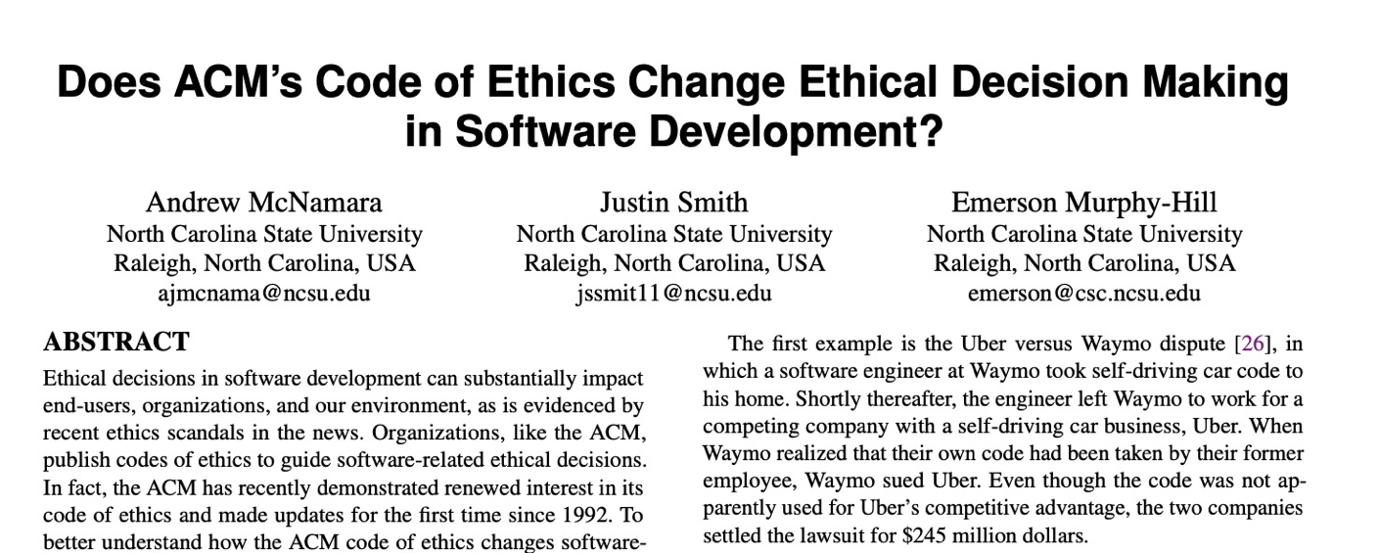

Code of Ethics
ACM’s Code of Ethics Software Engineers
tldr: “No”
1. PUBLIC – Software engineers shall act consistently with the public interest.
2. CLIENT AND EMPLOYER – Software engineers shall act in a manner that is in the best interests of their client and employer consistent with the public interest.
3. PRODUCT – Software engineers shall ensure that their products and related modifications meet the highest professional standards possible.
4. JUDGMENT – Software engineers shall maintain integrity and independence in their professional judgment.
5. MANAGEMENT – Software engineering managers and leaders shall subscribe to and promote an ethical approach to the management of software development and maintenance.
6. PROFESSION – Software engineers shall advance the integrity and reputation of the profession consistent with the public interest.
7. COLLEAGUES – Software engineers shall be fair to and supportive of their colleagues.
8. SELF – Software engineers shall participate in lifelong learning regarding the practice of their profession and shall promote an ethical approach to the practice of the profession.
1. PUBLIC – Software engineers shall act consistently with the public interest.
https://ethics.acm.org/code-of-ethics/software-engineering-code/
Notes:
Software Engineers are not legally held to any code of ethics, and unlike many other professionals (like lawyers, doctors, and civil engineers), we are not licensed by a professional society who holds us to ethical standards. Nonetheless, the ACM, one of the largest professional societies for computer scientists, has established a code of ethics for software engineers. This code is quite similar to those for professional engineers, and includes as the first tenet, (click) that software engineers should act consistently with the public interest - both doing no harm to the public, and hopefully doing good. (Click) studies have investigated whether simply exposing engineers to this code of ethics improves ethical decision making in software development (click), concluding that this code alone does not improve ethical decision making. Making ethical decisions often involve weighing multiple trade-offs: in the case of the Citigroup tower, the engineering firm (and their client, and their insurer) had to make a difficult ethical choice: should they immediately publicly disclose the fact that a strong wind could topple the tower - clearly a concern in the public interest, or should they instead prepare with officials to perform an emergency evacuation and monitor the weather closely without informing the public about the potential hazard (which could provoke unnecessary panic)?

Slide 8
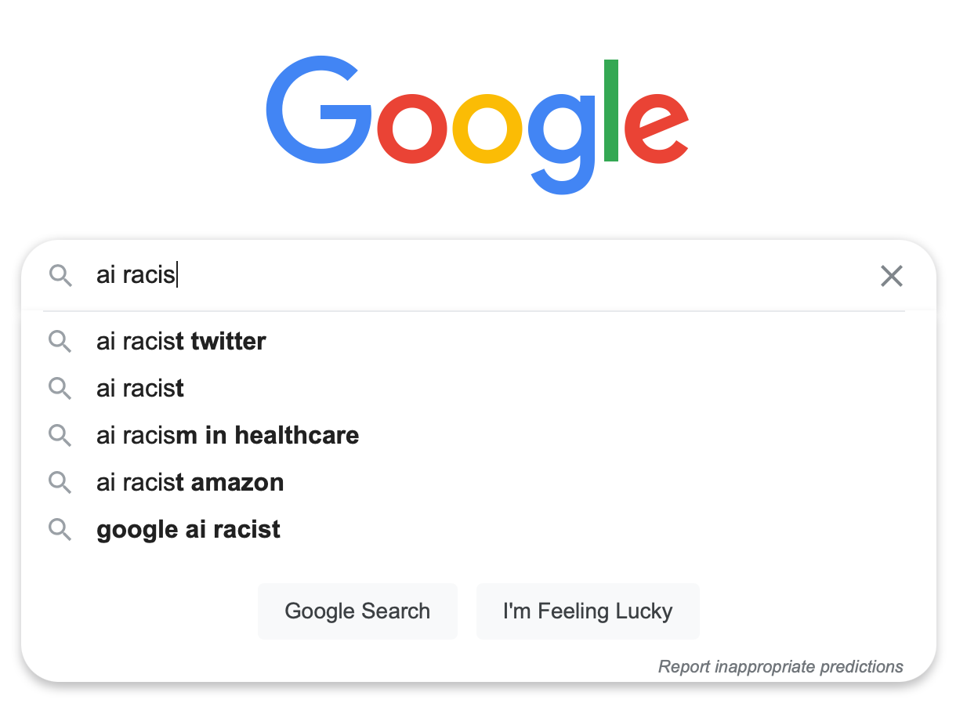
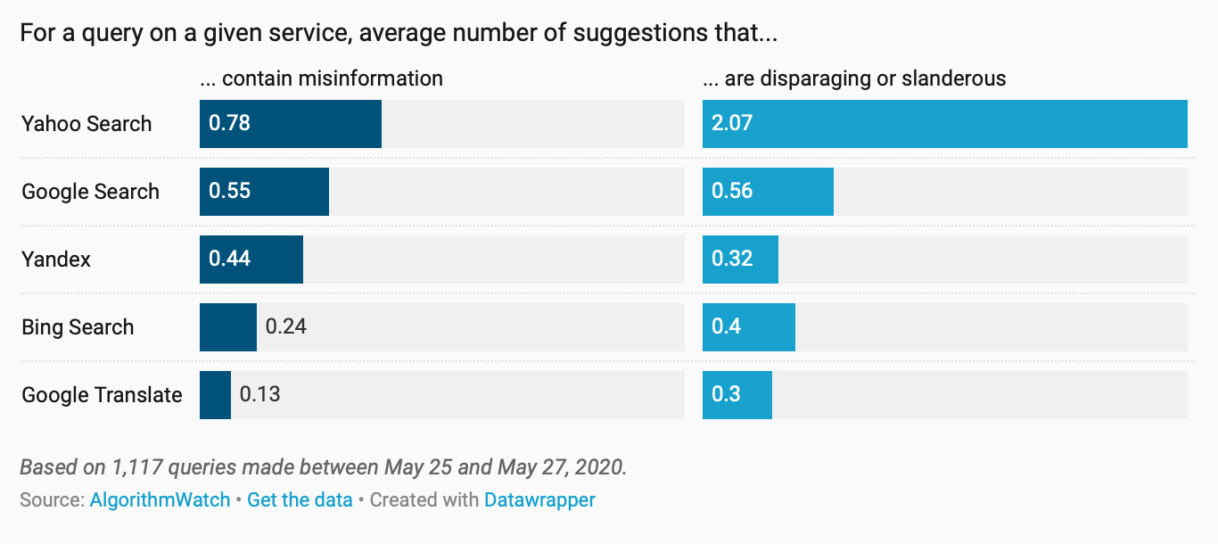
Ethical decisions are often hard decisions
Example: Text Recommendation
Interactive AI systems can be useful
Interactive AI systems can also amplify hate
Ethical and moral frameworks provide a lens to make rational decisions
Microsoft’s “Tay”
“Ten years on, search auto-complete still suggests slander and disinformation”
Notes:
In a software engineering scenario, we might consider the ethical issues surrounding text recommendation. On one hand, interactive AI systems can be useful - for instance, providing suggestions to auto-complete search terms. However, at the same time, these systems can amplify hate - a small population of motivated users can coerce these models into providing disparaging or slanderous recommendations, and entirely interactive AI chat-bots like Microsoft’s “Tay” can be trained in even worse ways. Yet, there is a scientific value to developing such technologies. Ethical frameworks can help balance tradeoffs like this, and are the topic for another class.

Slide 9
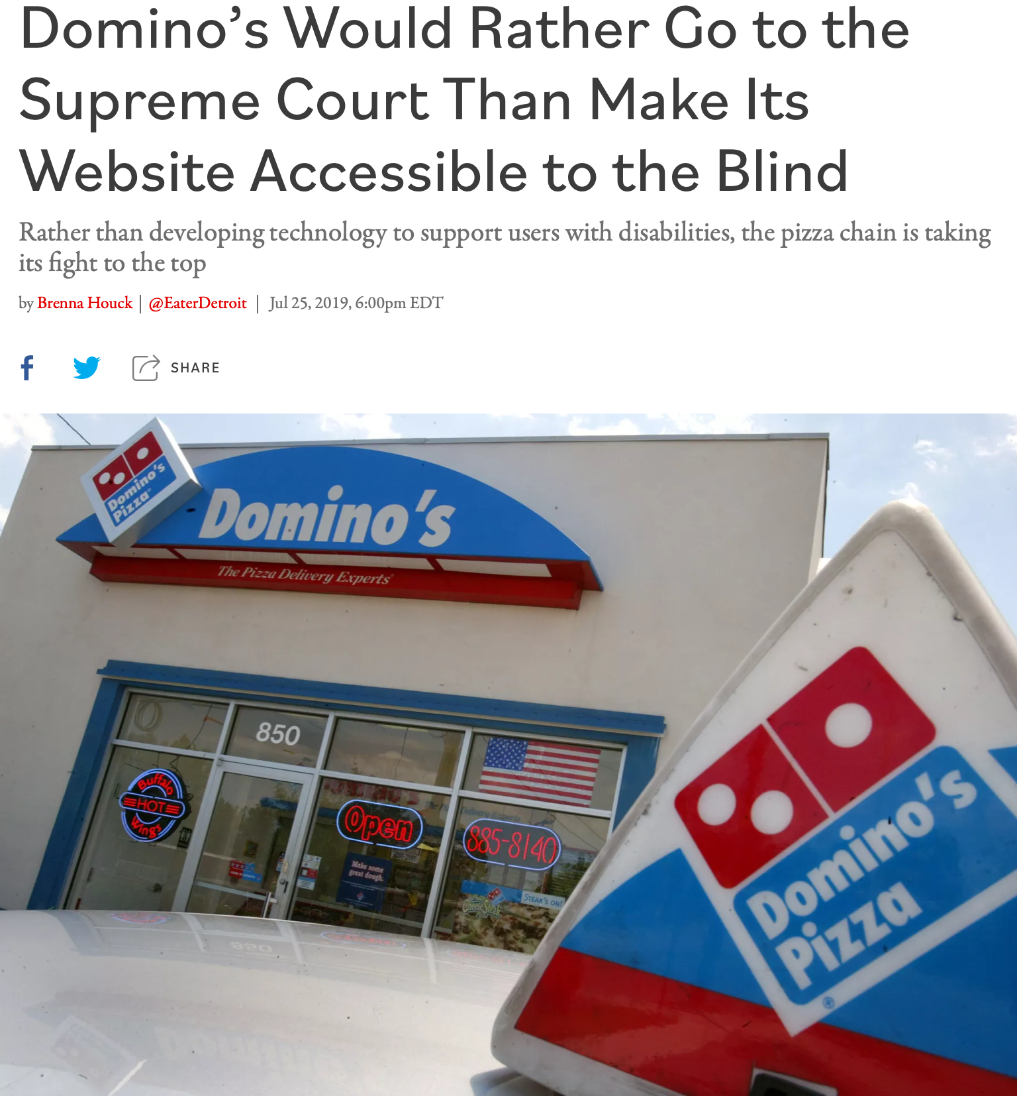
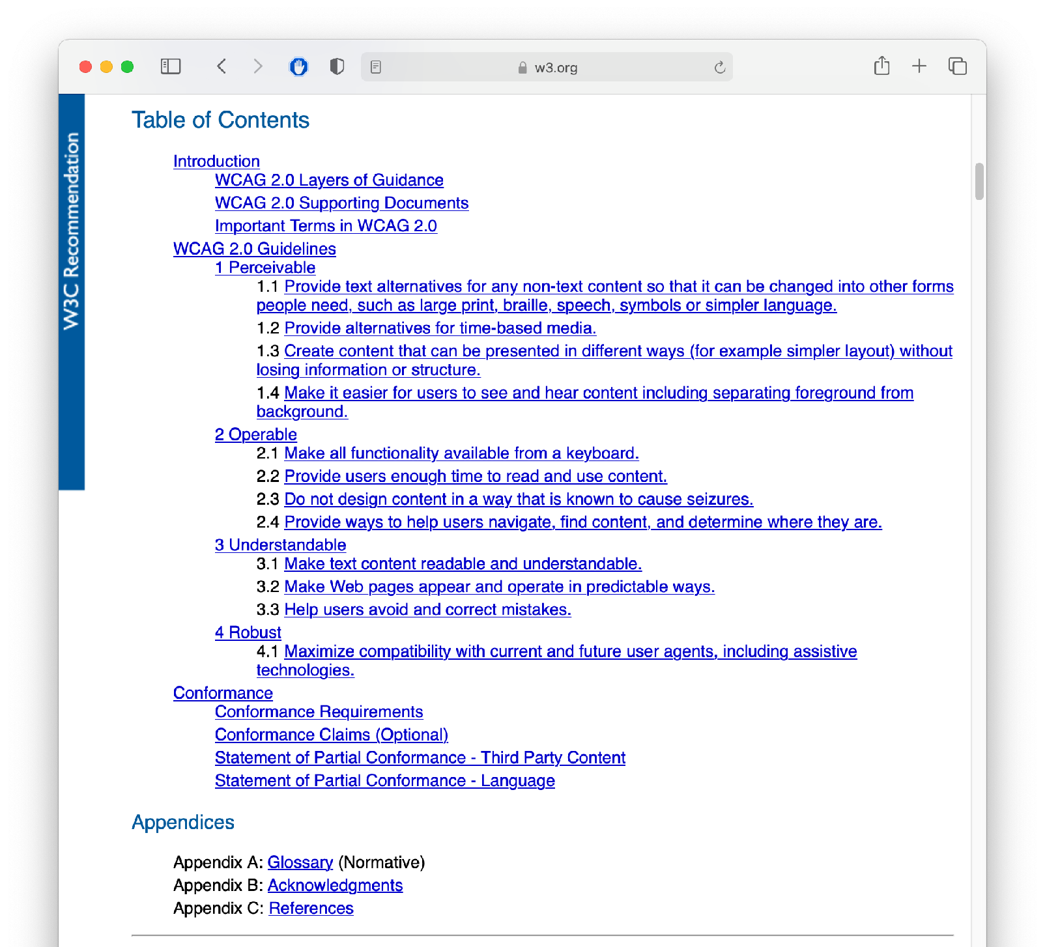
Accessibility should not be a hard decision
Example: Domino’s + ADA
WCAG 2.0 Specification
Notes:
Again, our focus is on identifying ways that the software that we engineer is or is not inclusive, and generally “good” - in ways that are hopefully more clear. For example, the case of Domino’s unwillingness to comply with the ADA and provide an accessible pizza online pizza ordering interface was a direct statement that Domino’s did not want to sell pizza online to blind customers. In court documents, Domino’s revealed it would have cost just $38,000 to resolve the raised accessibility issue (surely they would have made that back in pizza sales, or at least, would not have spent far more than that in legal fees). There was a standard that could have been followed. But, industry pressure prevailed.

Slide 10
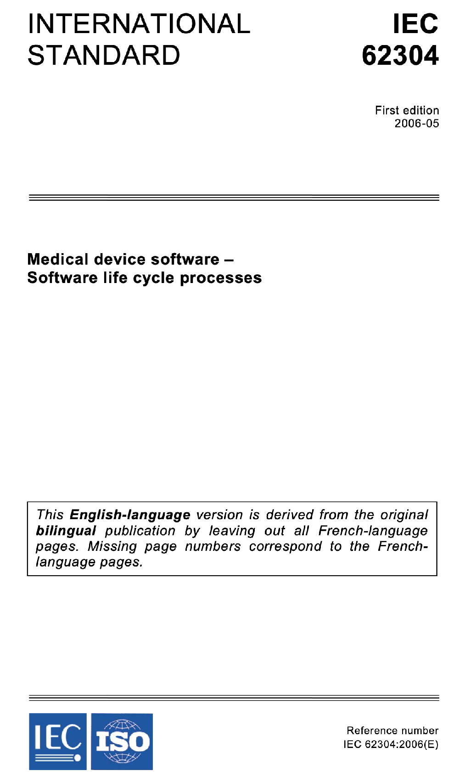
Safety-Critical Software Regulations
Standards for Software Development
International bodies define standard processes that are designed to protect the public
By (correctly) following such a standard, you can reduce the chance of harm to users, as well as your ethical (and legal) liability
Notes:
In a more crystal clear case, companies constructing medical device software must now comply with well-defined standard processes for developing that software in a way that will assure safety. Simply following the standard doesn’t guarantee safety, but doing so can help to ensure that it does, while also reducing our legal and moral liabilities.

Slide 11
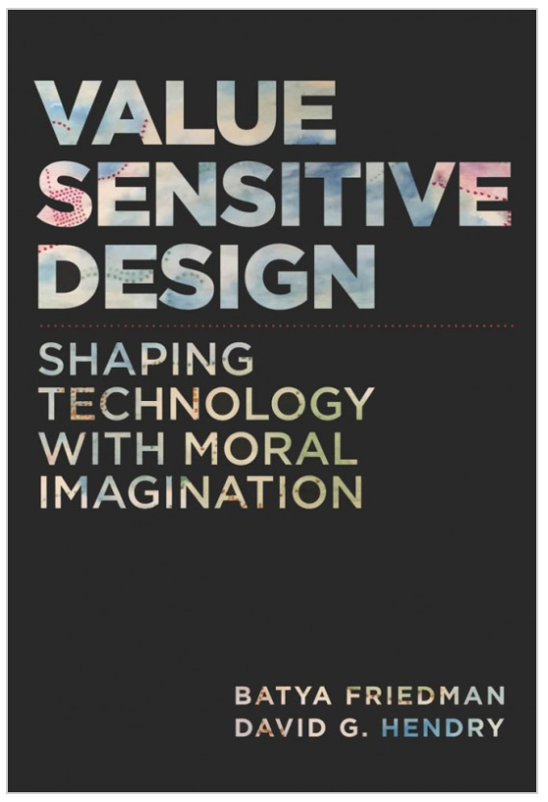
Value Sensitive Design
Consider how our software impacts users’ universal values [partial list]
Human rights - Inalienable, fundamental rights to which all people are entitled
Accessibility - Making all people successful users of the technology
Justice - Procedural justice (process is fair) + distributive justice (outcomes are fair)
Privacy - An individual’s agency in determining what information about them is shared
Human welfare - Physical, material and psychological well-being
Value Sensitive Design @ Khoury
Notes:
Aside from not causing physical harm to our users and providing an accessible interface, it might not be immediately obvious to you HOW your software will have an impact on people. Value-sensitive design is an approach to guide the design of technology while considering the impact of the technology on a variety of core human values. This approach can help us to identify unintended consequences of our software, which we can then begin to reason about. Core values include human rights, accessibility, justice, privacy and human welfare, and many others. As we think about the software that we’re building, we can ask ourselves explicitly: how does

Slide 12
Unpacking “Public Interest”
Do no harm: how can our software cause harm?
How can my software fail? What are the implications of that failure?
Who will use my software, and how might different users use it differently?
How will my software impact those who do not use it directly?
Will my software amplify negative behavior for users and society at large?
Notes:
So, when considering that we want to do no harm to the public interest, we might consider asking ourselves questions like this:
If there’s a bug in my software, what could be the resulting impact? What parts of my software will be most likely to have negative human impacts if buggy, and how do we test that part most effectively? Who will be the users of my software, and will it impact different users in different ways? Will my software disadvantage some users? Will there be a negative impact on people who do NOT use my software, for instance through climate, or through social forces?

Slide 13
Unpacking “Public Interest”
How can our software make a positive contribution?
Will my software make people’s jobs easier?
Will my software make people happier?
Will my software amplify positive behavior for users and society at large?
Notes:
Similarly, when we are trying to become excited about some software project and its potential for good, we might think about the potential for our software to make people’s jobs easier and make people happier, broadly amplifying positive behavior for our users and the general public. In particular, once we identify these goals, we can evaluate them as part of our software quality process

Slide 14
Where does this leave us?
So that we can sleep at night
Above all: try to do good - consider the impacts of your software on others
Follow best-practices, and actively push to improve them
Next lesson: How do we understand our users, so that we can make the best software, and cause the least unintended harm?
Notes:
There’s no silver bullet for ethical software development. However, hopefully now you understand better the different ways that our software can have impacts on others, and how we can reason about those implications. The next and final lesson in this module will examine how we can better understand our users, so that we can make the best, most inclusive software, and in turn, hopefully cause the least unintended harm.

Slide 15
This work is licensed under a Creative Commons Attribution-ShareAlike license
This work is licensed under the Creative Commons Attribution-ShareAlike 4.0 International License. To view a copy of this license, visit http://creativecommons.org/licenses/by-sa/4.0/
You are free to:
Share — copy and redistribute the material in any medium or format
Adapt — remix, transform, and build upon the material
for any purpose, even commercially.
Under the following terms:
Attribution — You must give appropriate credit, provide a link to the license, and indicate if changes were made. You may do so in any reasonable manner, but not in any way that suggests the licensor endorses you or your use.
ShareAlike — If you remix, transform, or build upon the material, you must distribute your contributions under the same license as the original.
No additional restrictions — You may not apply legal terms or technological measures that legally restrict others from doing anything the license permits.

